Slide 1
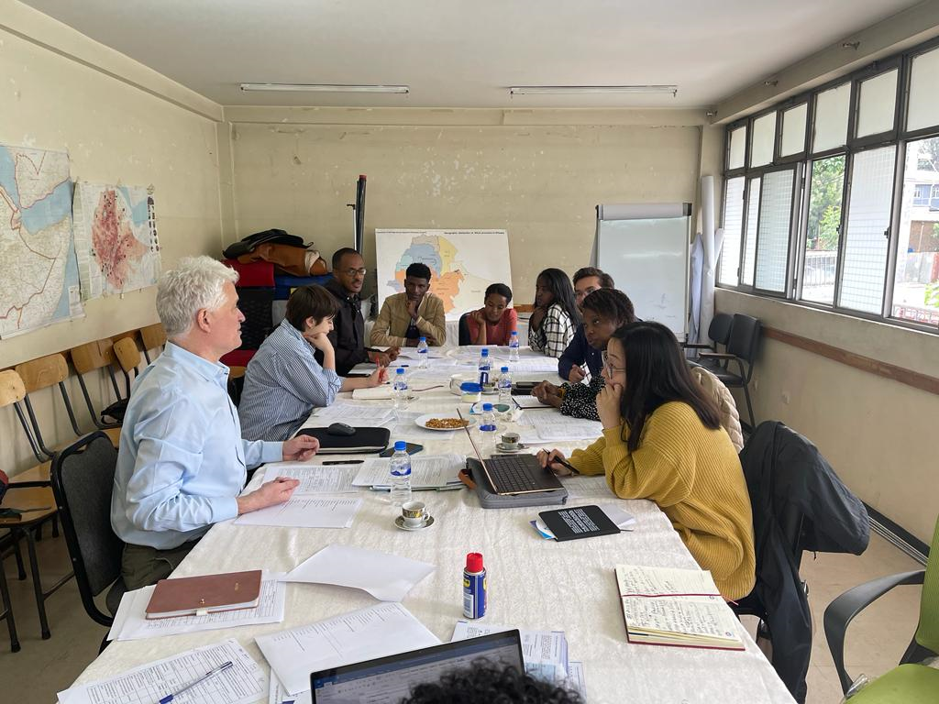
New School
and
CoSAP
Data Collection Presentation
Dermmillah Obare
Hannah Kim
Lauren Handley
Sahithi Shankaiahgari
Sebastian Dodd

Slide 2
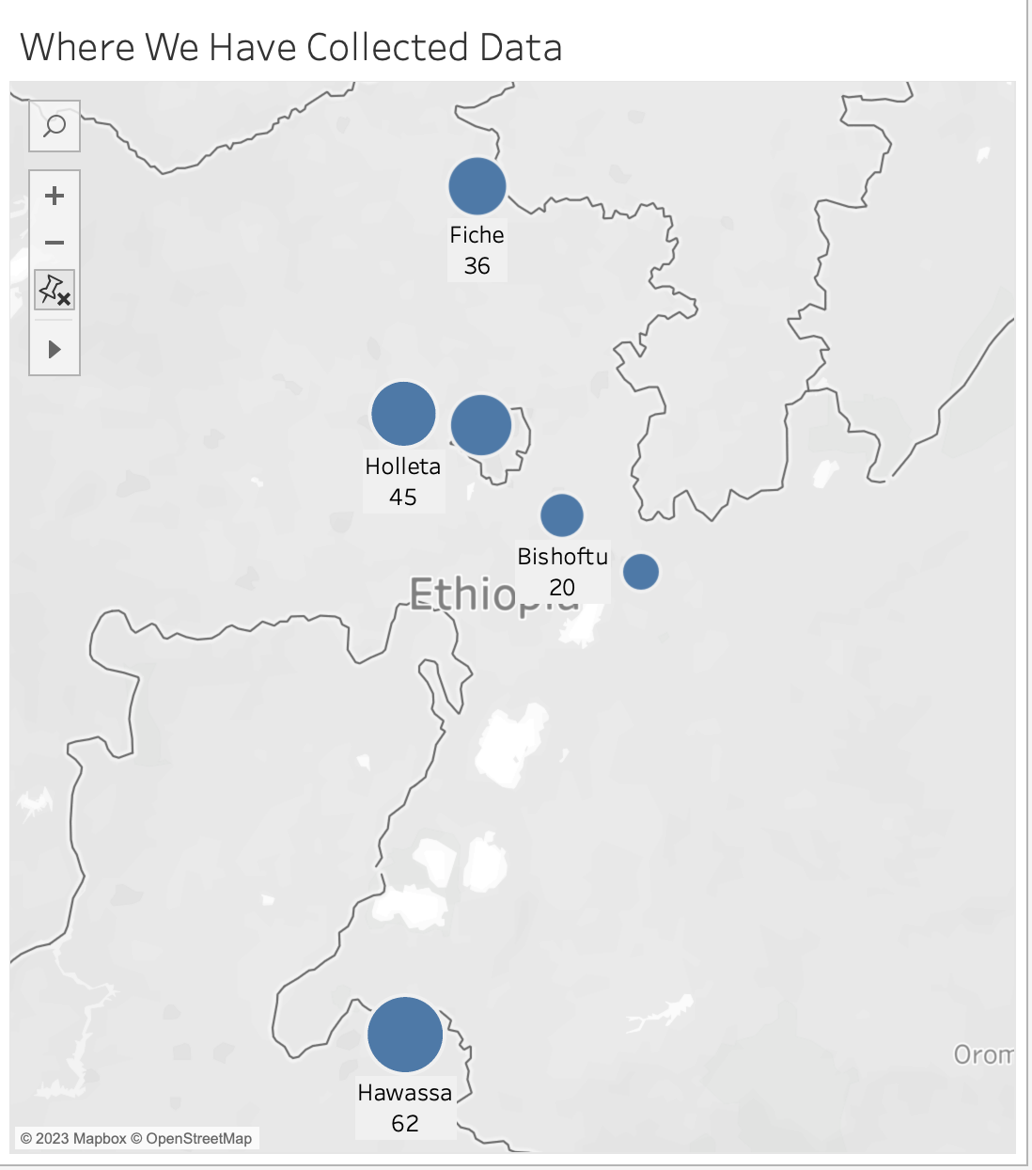
Methods: Data used and Where We Have Been
Addis Ababa
40…….
Data from 2022 and 2023
66 Collected this year
316 Prosperity Scorecards - 82% to statistically valid sample size.
Adama
14….

Slide 3
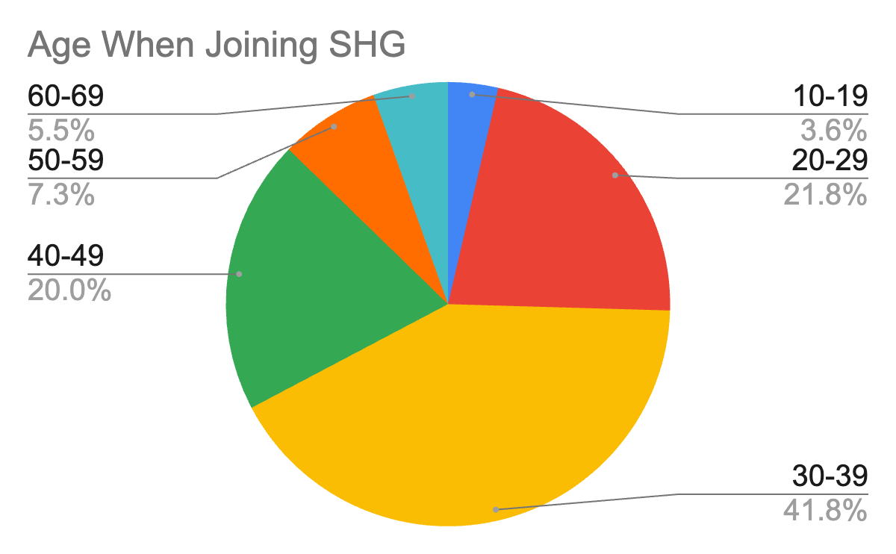
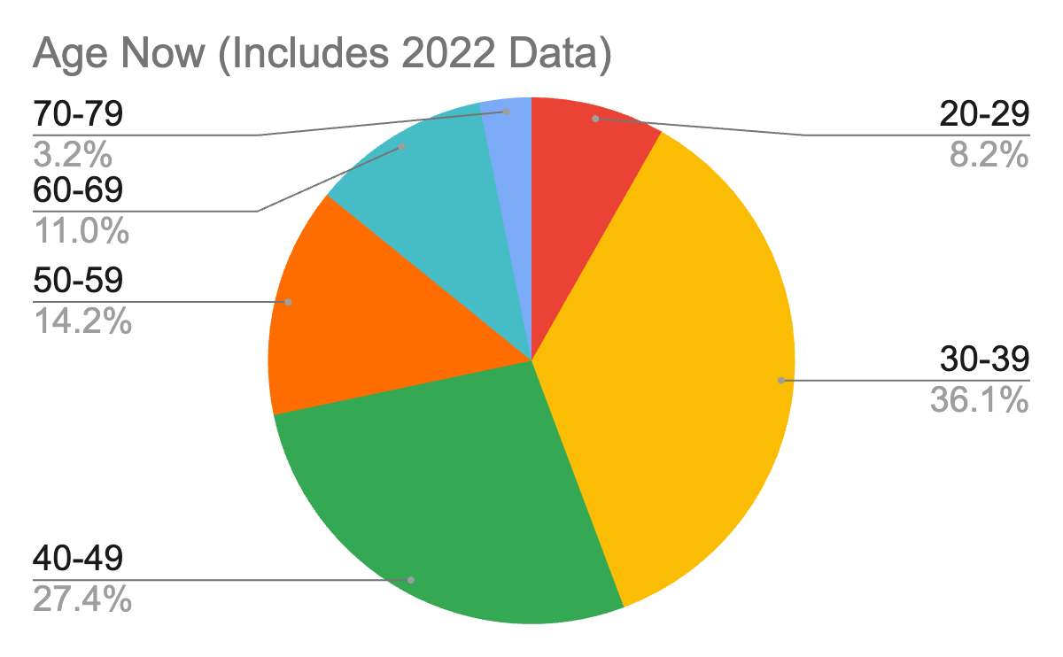
Age Demographic of Members
Average age over 40
Only 5 members in 20s, none below 24
Ethiopia has a young population, with 71% of people below the age of 30
What is keeping young women from joining an SHG?

Slide 4
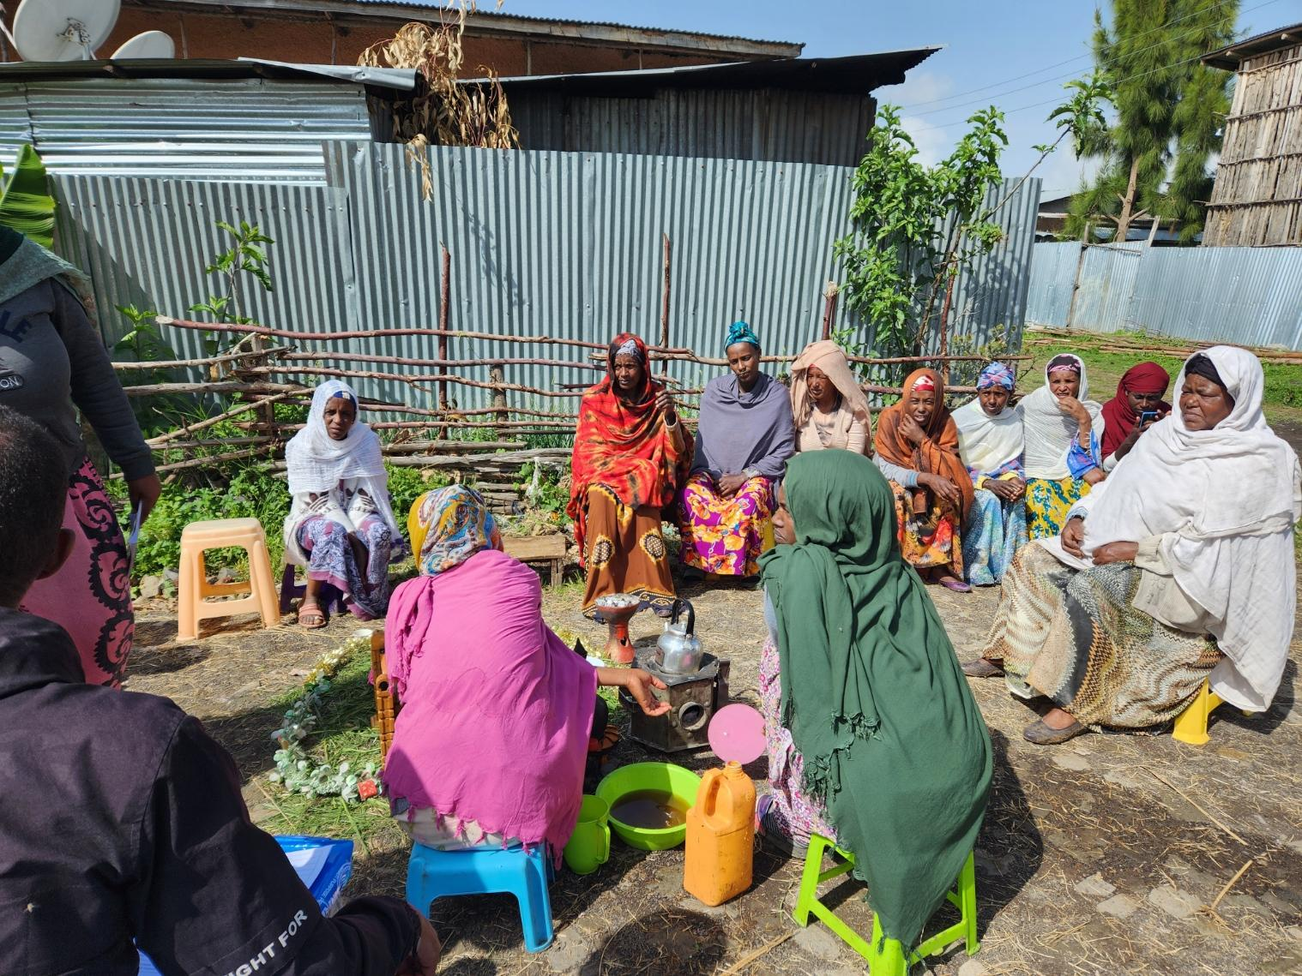
2023 Psycho-social Findings
Common problems:
COVID
Inflation
Taxes
Lack of access to funds and resources
Involvement in SHG turns women into advocates
Each region focuses on different issues:
Addis Ababa: economy (housing, food, inflation)
Fitche: children’s rights
Hawassa: women’s rights

Slide 5
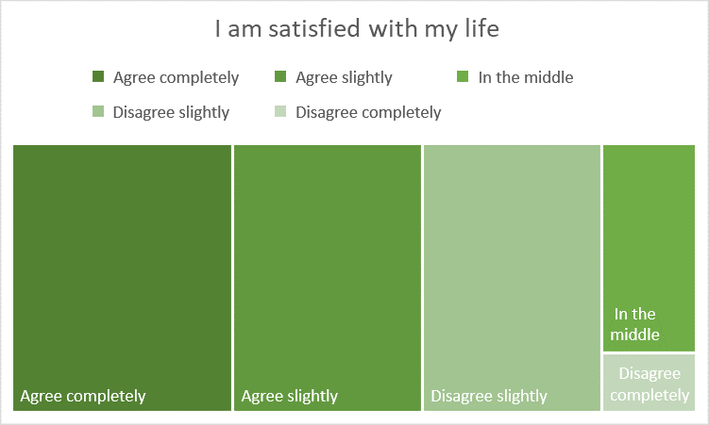
2023 Psycho-social Survey Results
60% agree/slightly agree that they are satisfied with life, while only 29% disagree/completely disagree

Slide 6
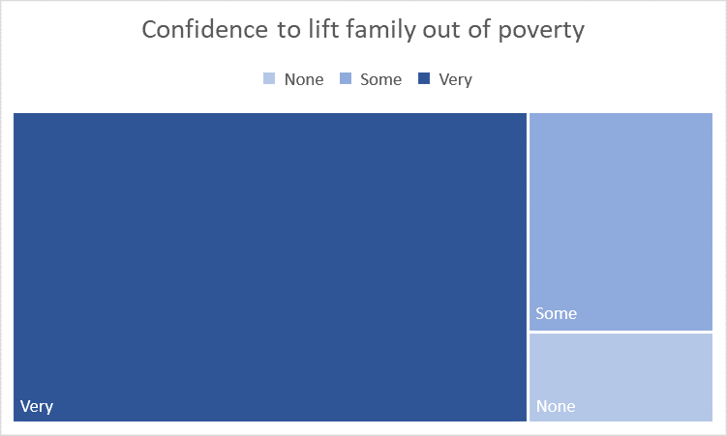
2023 Psycho-social Survey Results
73% are very confident that they will lift their family out of poverty

Slide 7
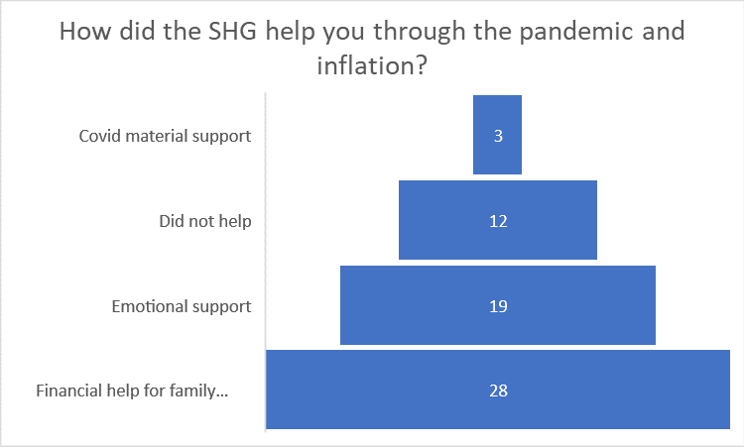
2023 Psycho-social Survey Results
45% of the women surveyed stated the SHG helped them stay afloat during the pandemic and inflation

Slide 8
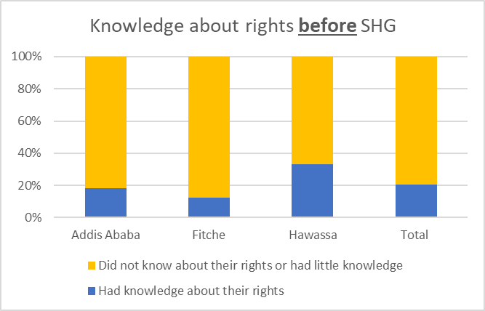
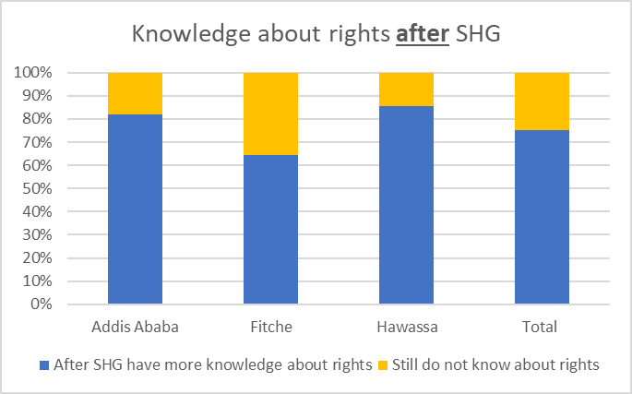
2023 Knowledge About Rights
Theory of change: membership in SHGs increases knowledge of human rights.

Slide 9
Change in perception of human rights
"Before, our voice used to be mute. Now we have space to share experiences. As a community, we work to bring out girls in domestic violence and provide guidance & justice."
Selamawit, Hawassa

Slide 10
"We used to be housewives, but now we are outside of our box, challenging the community and providing an example for others."
Alemesh Ledamo, Hawassa

Slide 11
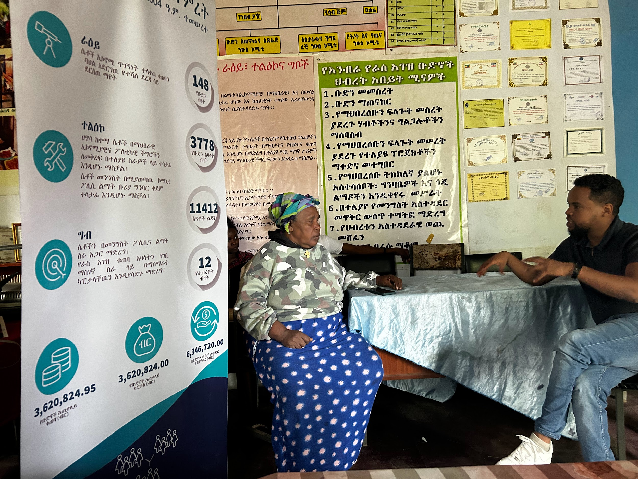
Human Rights Advocacy Efforts from SHGs, CLAs, & Federations
Federations: influencing laws and justice systems through collective action.

Slide 12
Human Rights Advocacy Efforts from SHGs, CLAs, & Federations
CLAs: working to change community practices towards women and children.
Children’s Groups
Health advocacy

Slide 13
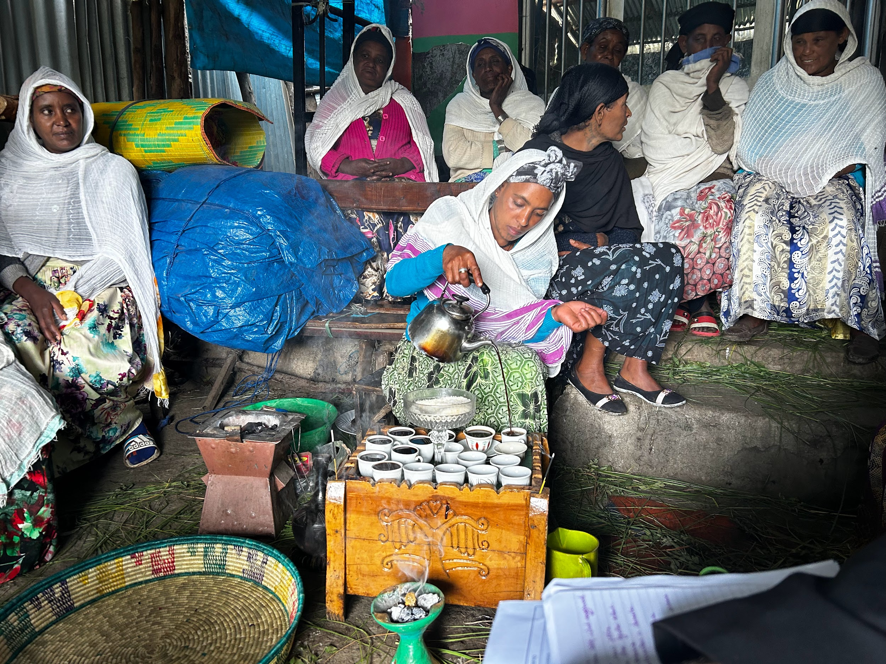
Human Rights Advocacy Efforts from SHGs, CLAs, & Federations
SHGs: empowering women to make changes in their homes and communities.

Slide 14
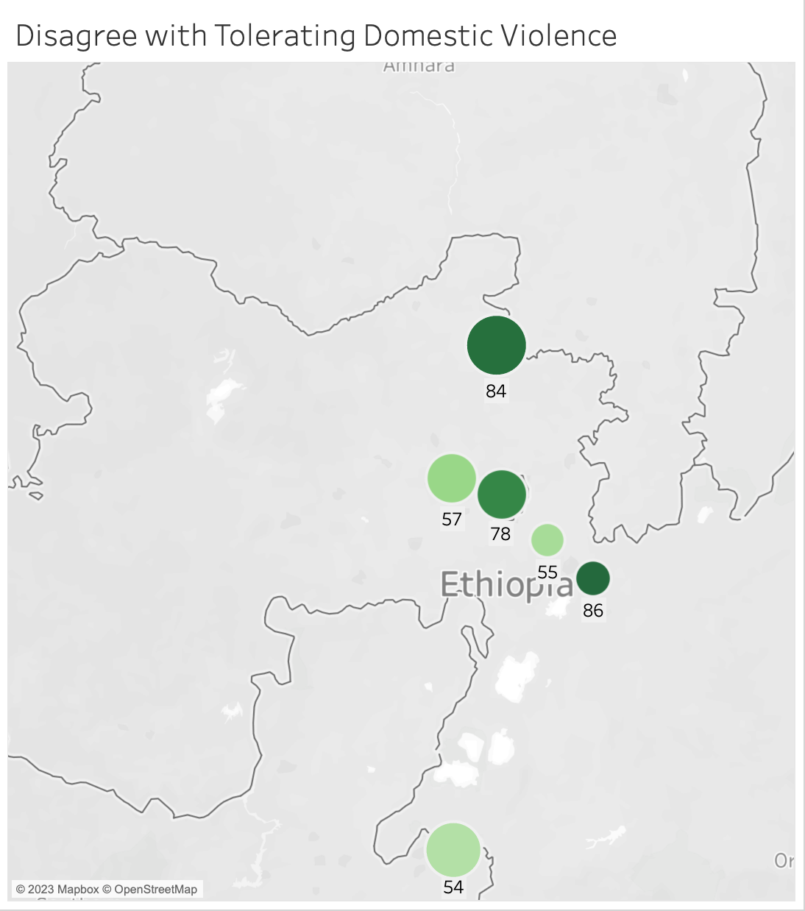
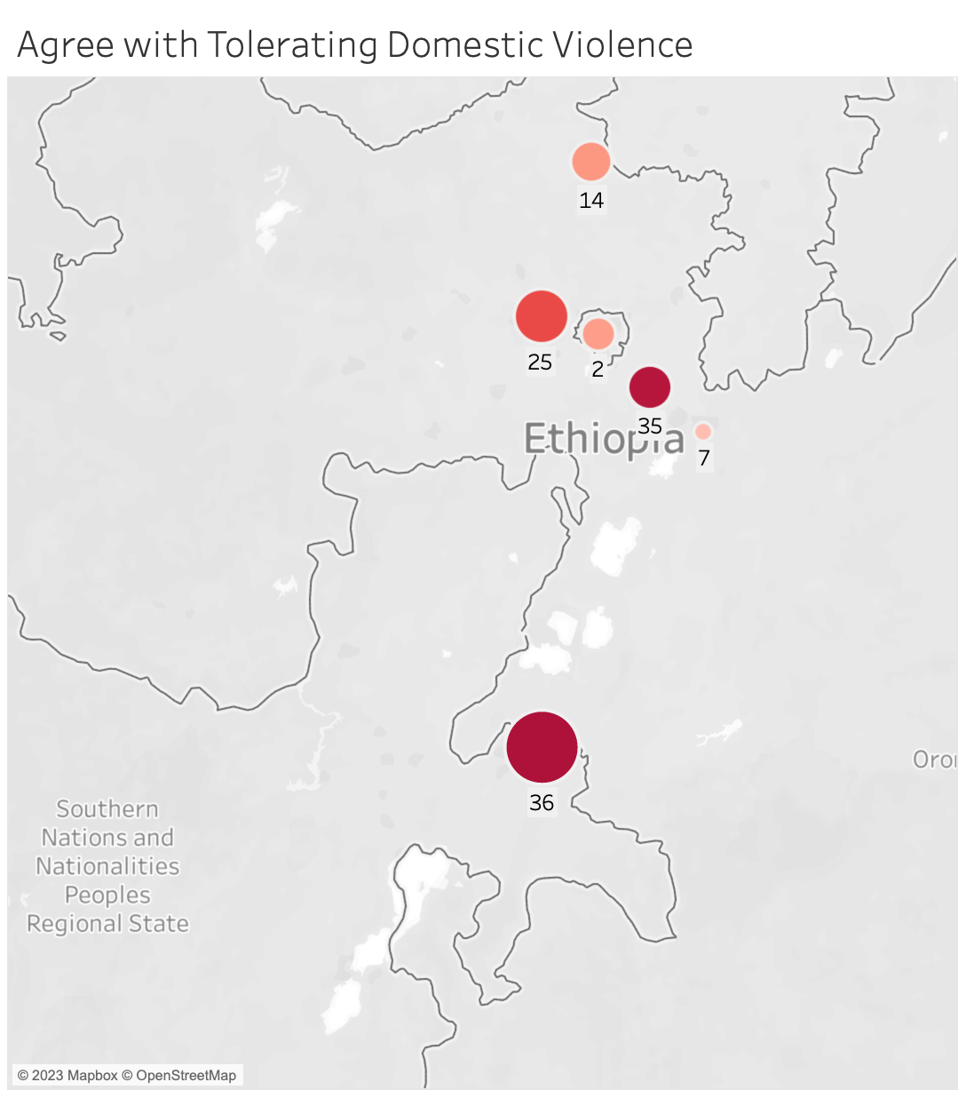
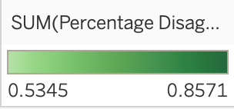
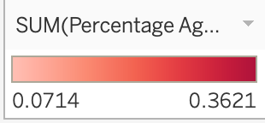
Regional Divide on Tolerating Domestic Violence
Notes:
Hawassa, Holeta and Bishfotu areas with highest percentage of respondents that agree with tolerating domestic violence

Slide 15
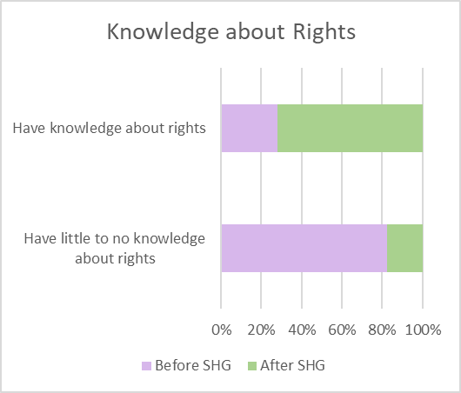
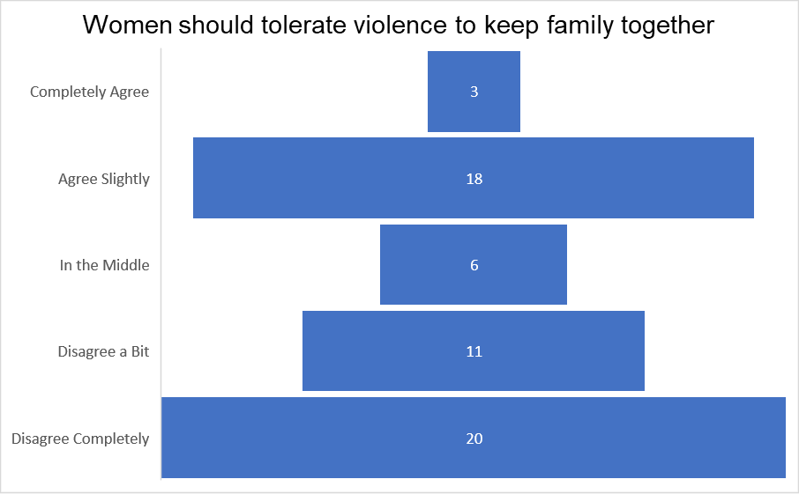
Hawassa
President of federation stated high # of sexual assaults and domestic abuse
Focuses on women’s rights & SHG members help sex workers
Increase in knowledge, yet half are in the middle/ agree women should tolerate violence
Even after joining SHG, 10 women in the middle/agreed did not change mind

Slide 16
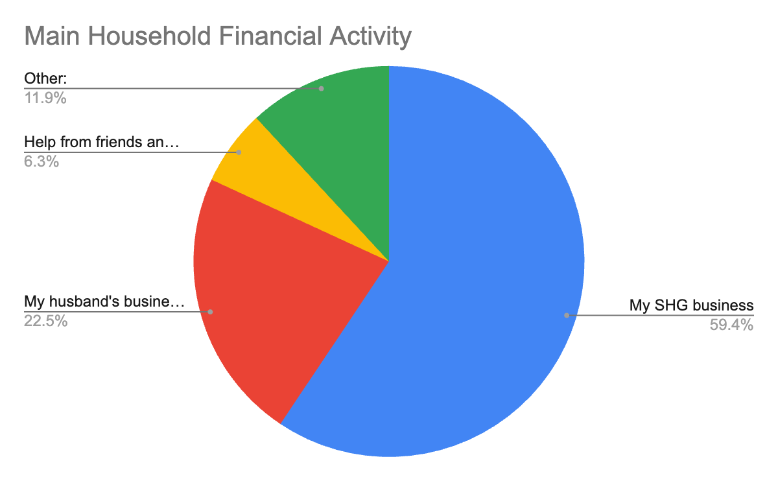
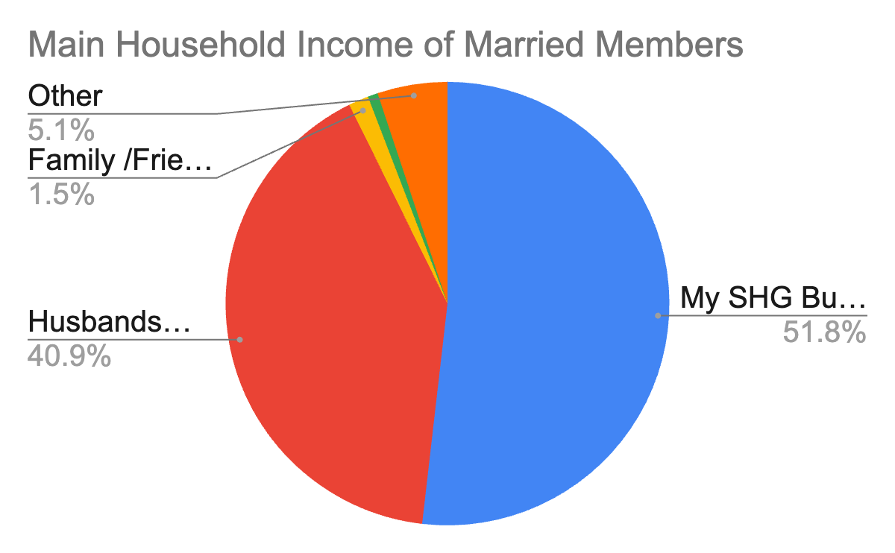
Main Household Income of SHG Members
Main Household Income for most SHG members is their SHG Business
This trend holds true even for married Members
Proves SHG businesses contribute significantly to members income

Slide 17
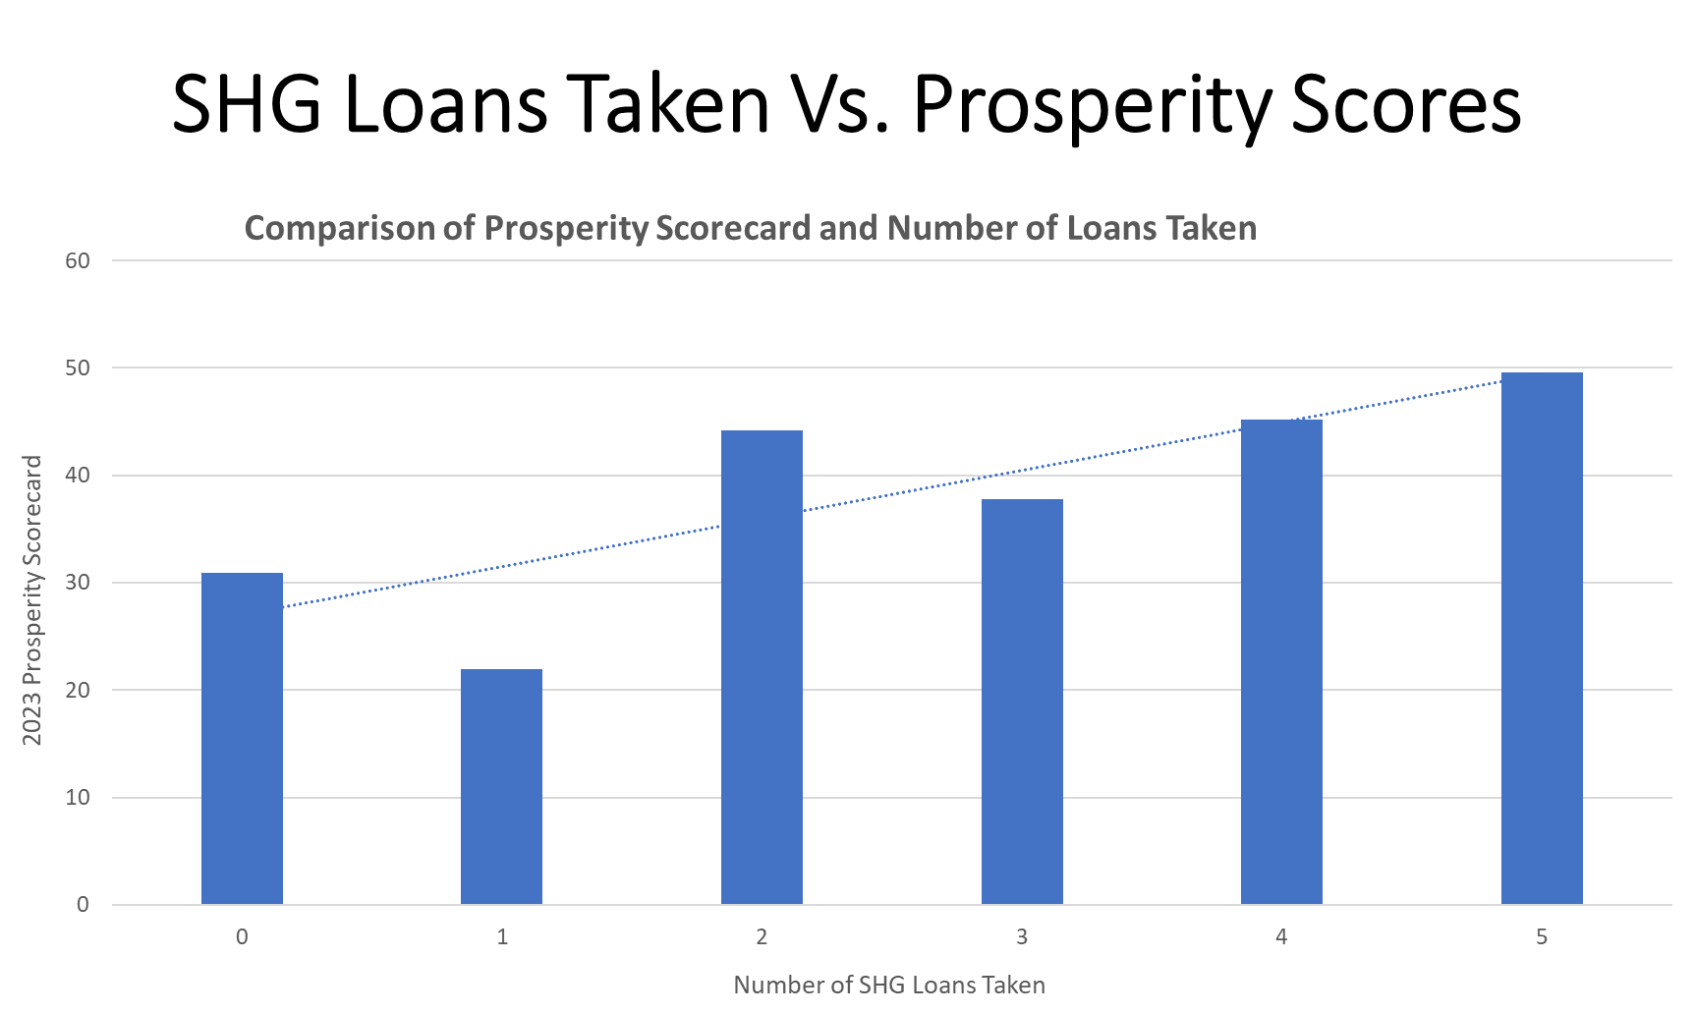

Slide 18
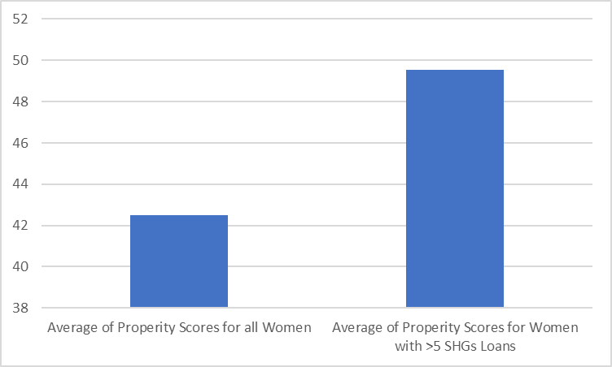
Prosperity
Prosperity

Slide 19
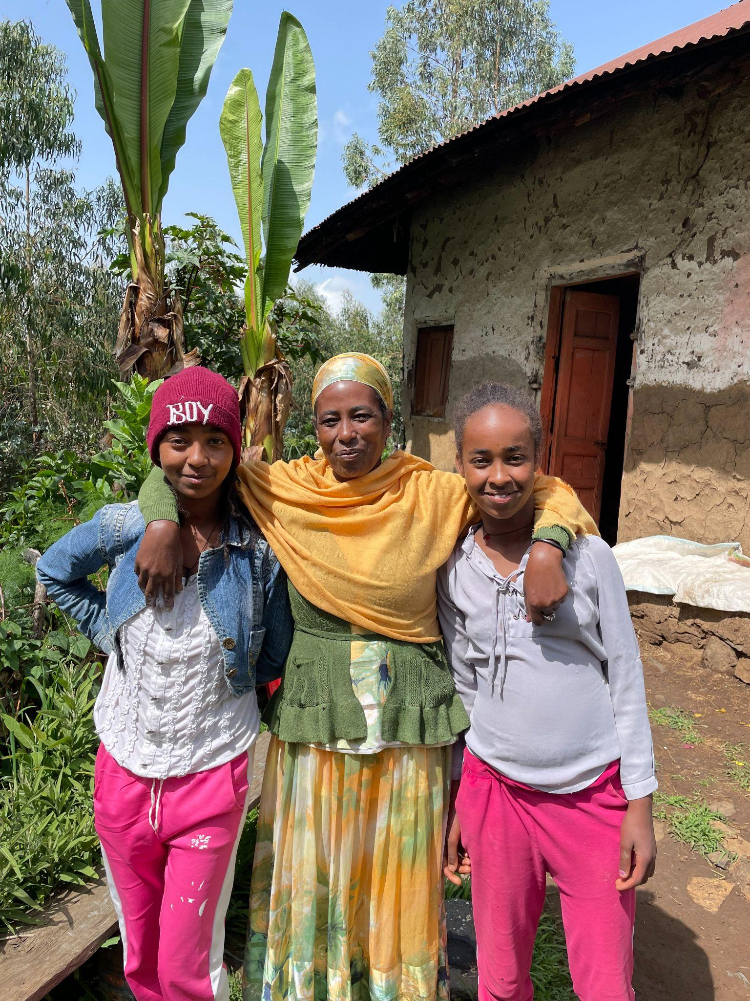
ATSEDE SHEFERAW

